Slide 1

Introduction to Ray Tracing
CS 296: Data Structures Honors Section Geometric Data Structures for Computer Graphics
UNIVERSITY OF ILLINOIS AT URBANA-CHAMPAIGN
Eric Shaffer

Slide 2
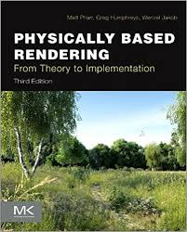
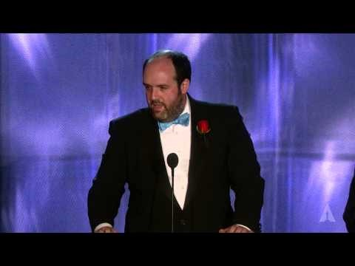
Great Moments in Computer Graphics…
Academy Award for Physcially-Based Rendering

Slide 3

Rendering by Simulating Light Transport

Slide 4
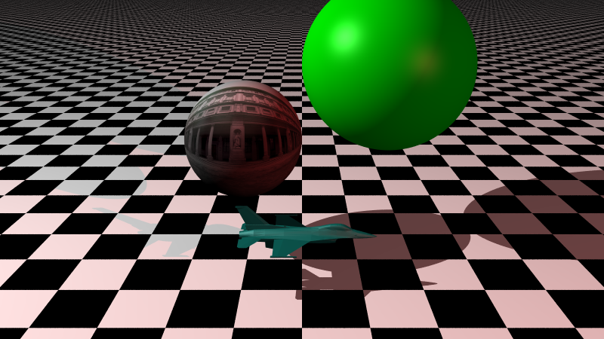
Another example

Slide 5
Some Research Areas in Rendering
Increase quality
More accurate modeling of the physics of light
Better models of materials
Reduce time
More efficient algorithms (numerical or otherwise)
Better data structures
Parallelism

Slide 6
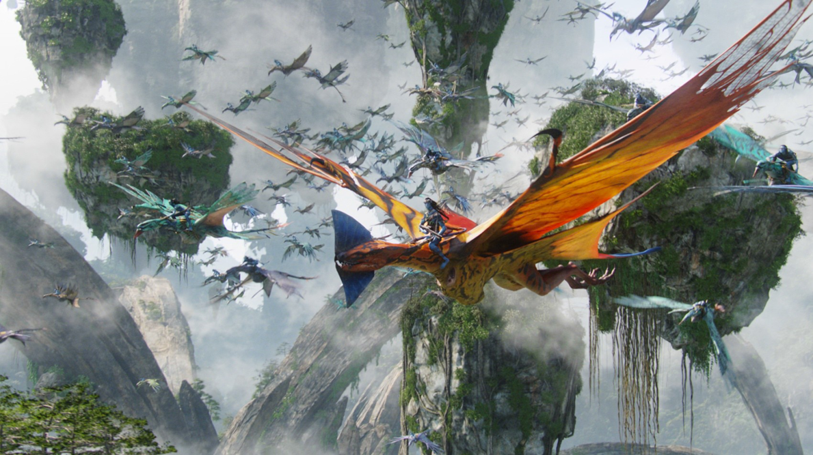
Managing Geometric Complexity
PantaRay: Fast Ray-Traced Occlusion Caching of Massive Scenes Pantaleoni et al., SIGGRAPH 2010

Slide 7
Some Stuff about the Class
Syllabus is on course website:
https://courses.engr.illinois.edu/cs419/index.html
We’ll use Piazza…I’ll create a folder on piazza
..and notify everyone by e-mail

Slide 8
Some Stuff about the Class
Grades probably on usual scale:
97 to 93: A
93 to 90: A-
90 to 87: B+
87 to 83: B
83 to 80: B-
…etc.
won’t be any tighter

Slide 9
Some Stuff about the Class
All programming assignments …you should have the chance to build something
MP1: 40%
MP2: 30%
MP3: 30%
Extra Credit MP

Slide 10
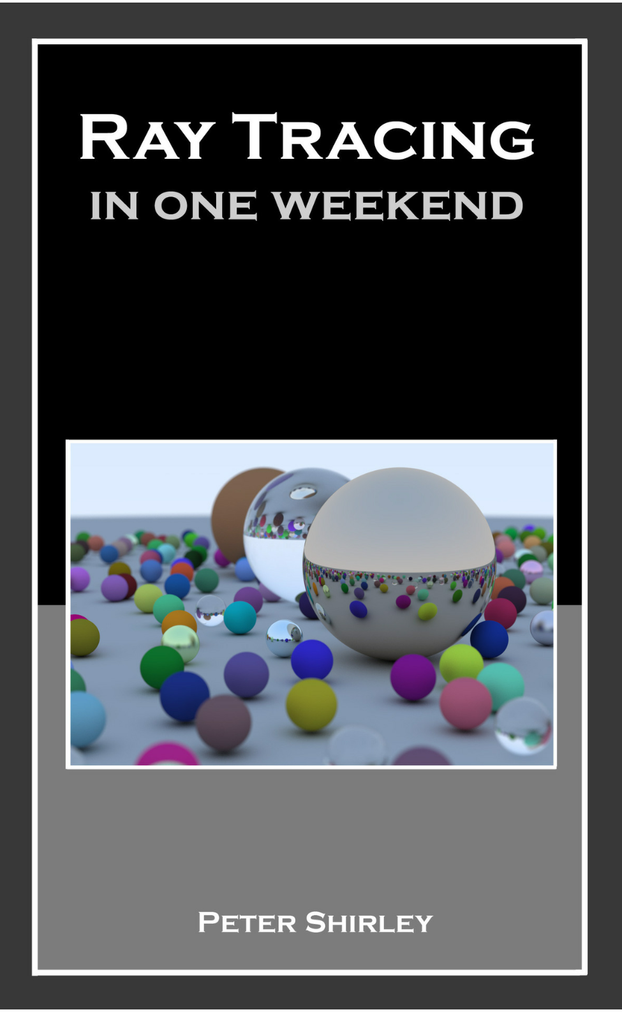
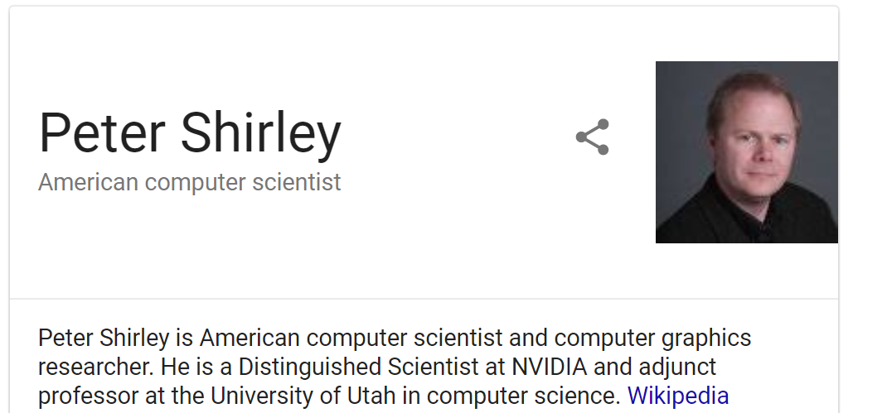
Some Stuff about the Class
Recommended text:
$2.99 on Amazon (Kindle edition)

Slide 11

Some Stuff about the Class
Recommended text:

Slide 12
Some Stuff about Coding
Use C++
Use the libpng
If you want, use libglm for math….
Help each other out on Piazza
You can use other people’s code.
You have to document your use
Failure to do so results in a 0 on the assignment

Slide 13
Our Model of Light Rays
Three key ideas about light rays
Light travels in straight lines (mostly)
Light rays do not interfere with each other if they cross
Light rays travel from light sources to the eye, but the physics is invariant under path reversal–reciprocity

Slide 14
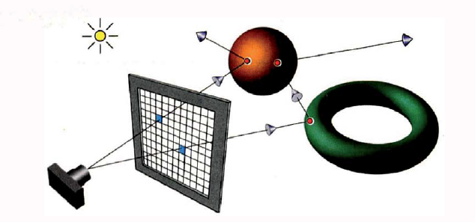
Ray Tracing
Figure from Ray Tracing from the Ground Up by Kevin Suffern

Slide 15

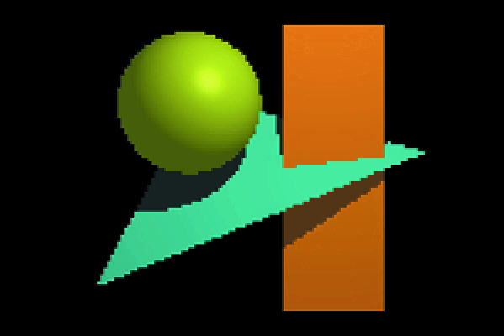
Resolution

Slide 16
Ray Tracing – basic algorithm
define some objects
specify a material for each object
define some light sources
define window that consists of a grid of pixels (the view plane)
for each pixel
shoot a ray into the model world
compute the intersection of the ray with each object
find the intersection (if any) closest to the view plane
if there was an intersection
use lights and material to compute the pixel color
else
pixel is set to background color

Slide 17
Well…actually we’re ray-casting
We can also cast some other rays to achieve other effects
That’s when we are able to say we ray-tracing
Types of rays:
Primary rays – rays shot from pixel (or eyepoint) into the world
Secondary rays
Shadow rays
Light rays
Notes:
What is the difference between pixel and eyepoint? What do we achieve?
Secondary rays are reflected rays – what kind of effect?
Shadow rays let us do shadows -- how could we do that? Where do they start and end?
Light rays start at the light. What effect do they give us? Why don’t we start the primary rays at the light?

Slide 18
Orthographic ray-tracing
Figure from Ray Tracing from the Ground Up by Kevin Suffern

Slide 19
Orthographic ray-tracing
Figure from Ray Tracing from the Ground Up by Kevin Suffern

Slide 20
Rays
p is a point on the ray
o is point that is origin of the ray
t is scalar parameter
d is unit vector giving the direction of the ray

Slide 21
Intersecting Rays and Implicit Surfaces
We can intersect an implicit surface with a ray
Just find the point p on the ray that satisfies the equation for the implicit surface
For now, we’ll just focus on planes and spheres….

Slide 22
Plane Equation
Here a is a point on the plane And n is the normal
All points p that satisfy the equation form the plane

Slide 23
Ray-Plane Intersection
the plane equation with normal n and point on plane a
What happens if d is parallel to the plane?
How do you know if the hit happens in front or behind the view plane?

Slide 24
Ray-Sphere Intersection
Equation of a sphere
So…a quadratic equation that we can solve

Slide 25
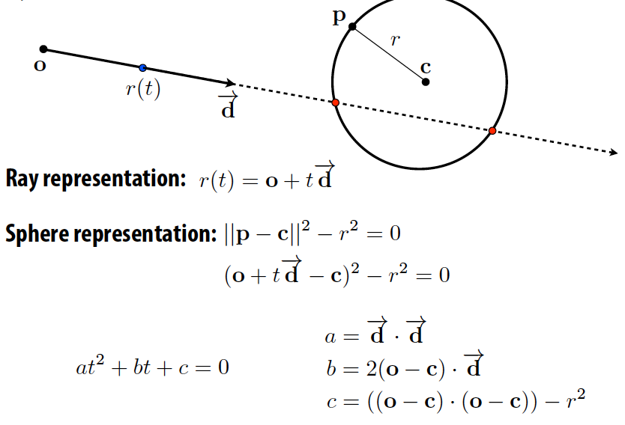
Ray-Sphere Intersection
Slide from CS348b: Image Synthesis by Matt Pharr

Slide 26
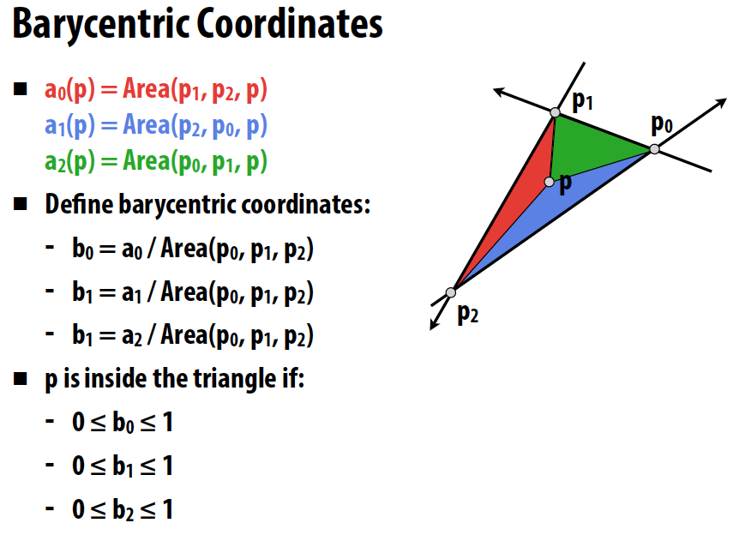
Point in Triangle Test
←should be b2
Slide from CS348b: Image Synthesis by Matt Pharr
Notes:
Can you implement a ray-triangle intersection test?

Slide 27
Barycentric Coordinates for Triangles
Describe location of point in a triangle in relation to the vertices
p=(λ₁,λ₂ ,λ₃) where the following are true
p=λ₁a + λ₂ b +λ₃c
λ₁+λ₂ +λ₃= 1
To interpolate a function sampled
at the vertices we just do:
f(p)=λ₁f(a) + λ₂ f(b) +λ₃f(c)
a
p
b
c

Slide 28
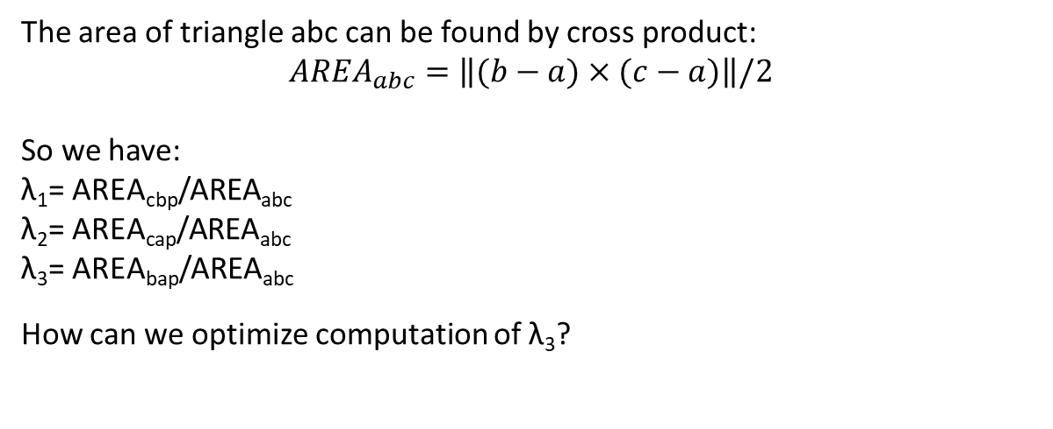
Barycentric Coordinates for Triangles
The area of triangle abc can be found by cross product: $${AREA}_{abc}=\left\|(b−a)×(c−a)\right\|/2$$
So we have:
λ₁= AREA_{cbp}/AREA_{abc}
λ₂= AREA_{cap}/AREA_{abc}
λ₃= AREA_{bap}/AREA_{abc}
How can we optimize computation of λ₃?
a
Coordinates are the signed area of the
opposite subtriangle divided by area of the triangle
A_{cap}
A_{bap}
p
A_{cbp}
b
c

Slide 29
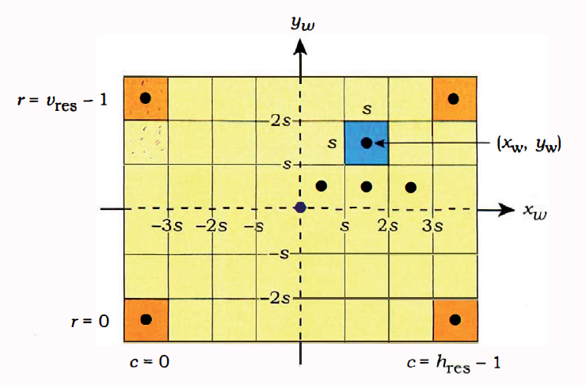
Computing Pixel Coordinates

Slide 30


What Changed?

Slide 31
Changing Field of View

Slide 32
Implementation Tips
Don’t feel compelled to use the code from the book
It may be easier to write it yourself
Choose a good, easy-to-use library for vector-matrix math
…feel free to post suggestions on piazza
Debug using single pixel images when possible
Use test-driven development
As you incrementally add functions…
…write test executables for all major functions

